Slide 1
Design and Analysis of Algorithms CS345
Lecture 8
Job scheduling problem
Huffman code : A data compression algorithm
Greedy paradigm

Slide 2
A Job scheduling problem

Slide 3





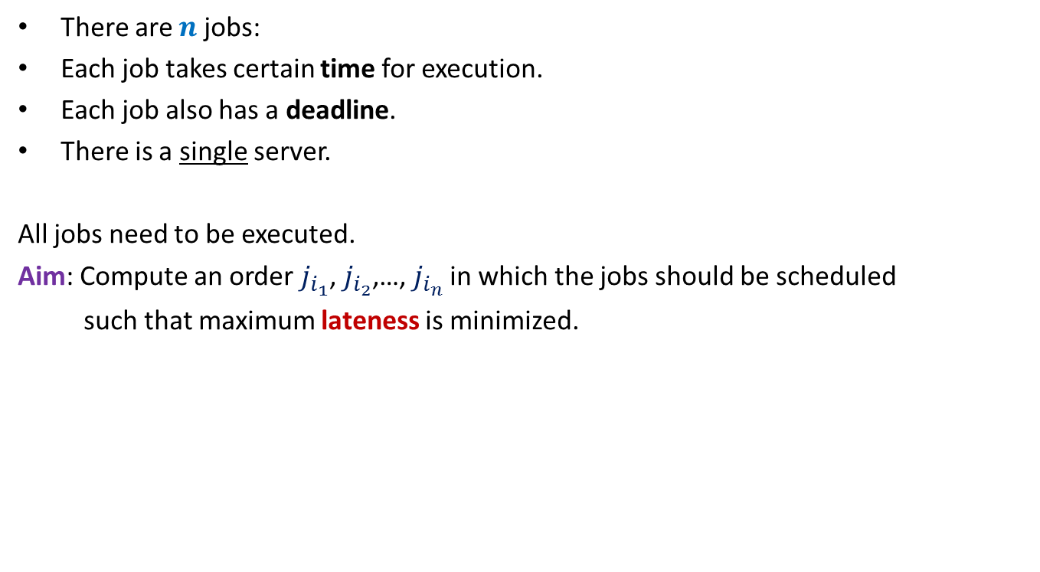








There are $n$ jobs:
Each job takes certain time for execution.
Each job also has a deadline.
There is a single server.
All jobs need to be executed.
Aim: Compute an order $j_{i_{1}}$, $j_{i_{2}}$,…, $j_{i_{n}}$ in which the jobs should be scheduled
such that maximum lateness is minimized.
$j_{1}$, $j_{2}$,…, $j_{n}$
Job $j_{i}$ takes $t_{i}$ time
Job $j_{i}$ has deadline $d_{i}$
$$f_{i_{k}}$$
$$d_{i_{k}}$$
$$d_{i_{k}}$$
Lateness of $j_{i_{k}}$
$$j_{i_{1}}$$
$$j_{i_{2}}$$
$$j_{i_{3}}$$
$$j_{i_{k}}$$
$$j_{i_{n}}$$
$$0$$
time

Slide 4













Example for a better understanding
$$t_{1}$$
$$j_{1}$$
$$d_{1}$$
$$t_{2}$$
$$j_{2}$$
$$d_{2}$$
$$t_{3}$$
Maximum lateness
$$j_{3}$$
$$d_{3}$$
$$j_{1}$$
$$j_{3}$$
$$j_{2}$$
time
$$0$$

Slide 5

Towards designing an algorithm
Each job $j_{i}$ has two parameters
Time of execution $t_{i}$
Deadline $d_{i}$
Idea 1: Schedule the jobs in the increasing order of Time of execution.
Try to prove correctness
Try to come up with a counter example
Let us try this first

Slide 6





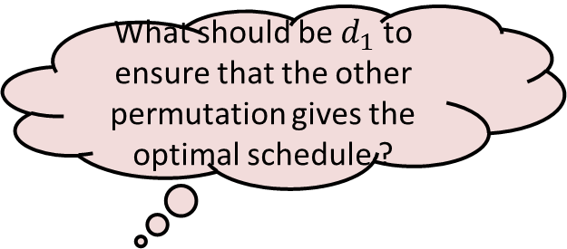


Towards designing a counterexample
What should be $d_{1}$ to ensure that the other permutation gives the optimal schedule ?
$$t_{1}$$
$$j_{1}$$
$$t_{2}$$
$$j_{2}$$
$$d_{2}$$
$$j_{1}$$
$$j_{2}$$
time

Slide 7

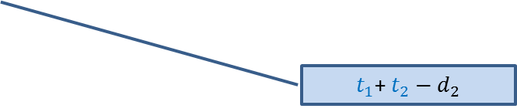

Towards designing a counterexample
Towards designing an algorithm
The job with farther deadline should be scheduled later.
the job with earlier deadline should be scheduled first.
$$t_{1}$$
This counterexample hints at a very important point as well.
$$j_{1}$$
?
$$d_{1}$$
$$t_{2}$$
$t_{1}$+ $t_{2}−d_{1}$
$$j_{2}$$
?
$$d_{2}$$
$t_{1}$+ $t_{2}−d_{2}$
$$j_{1}$$
$$j_{2}$$
time

Slide 8
How to schedule more than 2 jobs ?
time
$$0$$

Slide 9
How to schedule more than 2 jobs ?
Schedule the jobs in increasing order of their deadlines.
Homework:
Write a neat pseudocode of an efficient algorithm for this problem.
Write a formal proof of correctness of the algorithm.
time
$$0$$

Slide 10

The last 2 problems we discussed
Synchronizing the delays in a circuit
Scheduling jobs to minimize maximum lateness
Electric signal
6
5
3
2
4
2
$$0$$
time
2
1
6
2
1
2
3
2
A local approach
Optimizing a global function

Slide 11
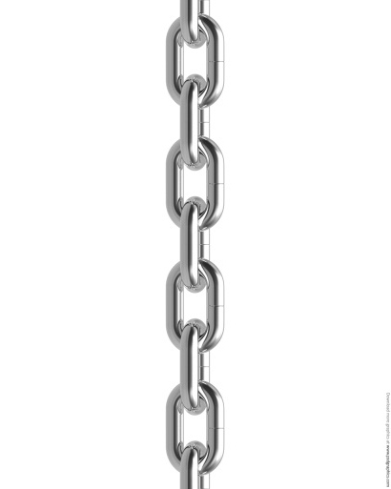


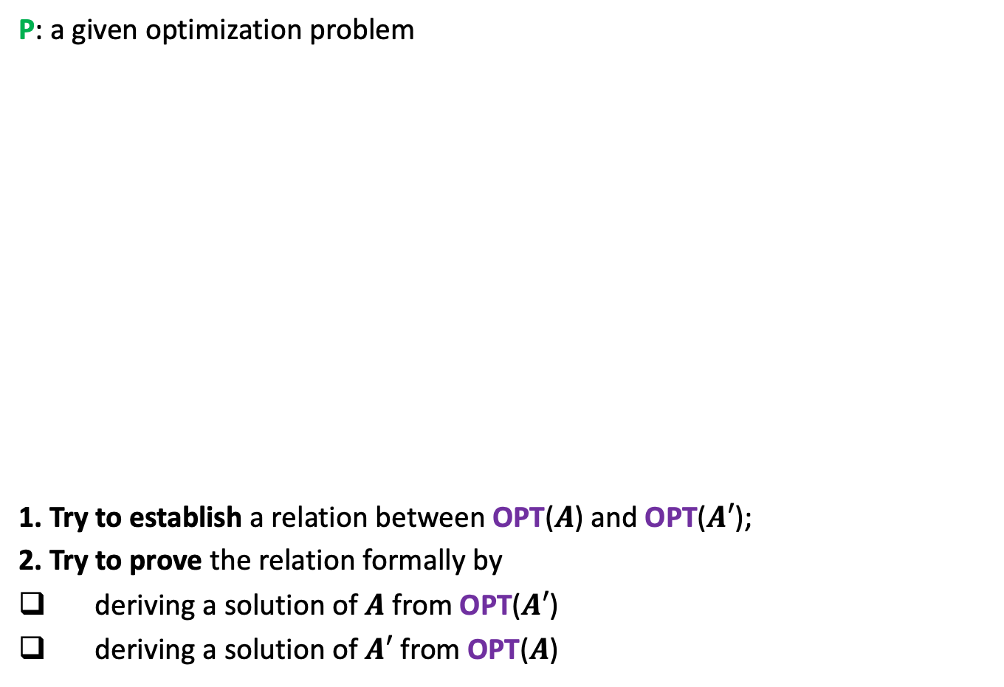


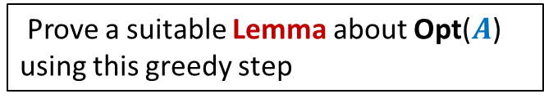


A generic way to prove that a greedy strategy works
P: a given optimization problem
1. Try to establish a relation between OPT($A$) and OPT($A′$);
2. Try to prove the relation formally by
deriving a solution of $A$ from OPT($A′$)
deriving a solution of $A′$ from OPT($A$)
If you succeed,
you have an algorithm
Opt($A$)
$$A$$
instance of size $n$of problem P
Greedy
step
Relation ?
Prove a suitable Lemma about Opt($A$) using this greedy step
Opt($A′$)
$$A′$$
instance of size $<n$of problem P
from construction
use Lemma

Slide 12
Huffman Codes
A novel and quite inspiring application of greedy algorithms

Slide 13

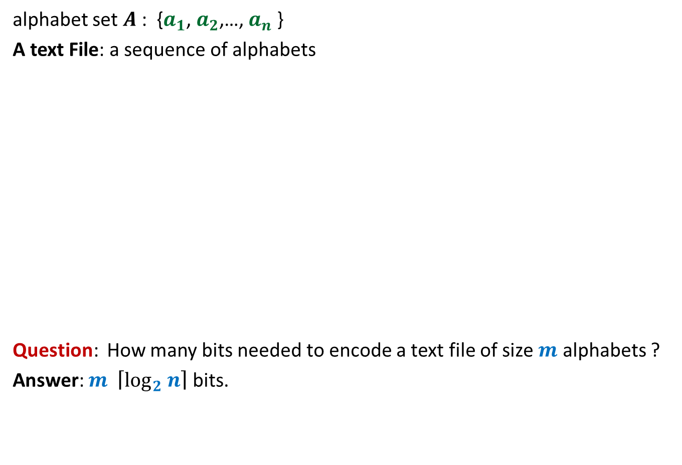
Binary coding
alphabet set $A$: {$a_{1}$, $a_{2}$,…, $a_{n}$ }
A text File: a sequence of alphabets
Question: How many bits needed to encode a text file of size $m$ alphabets ?
Answer: $m \left\lceil \log_{2} n\right\rceil$ bits.
once upon a time …………..
…………………………….
……………………………..
…………………
A text file F
Binary coding of F

Slide 14
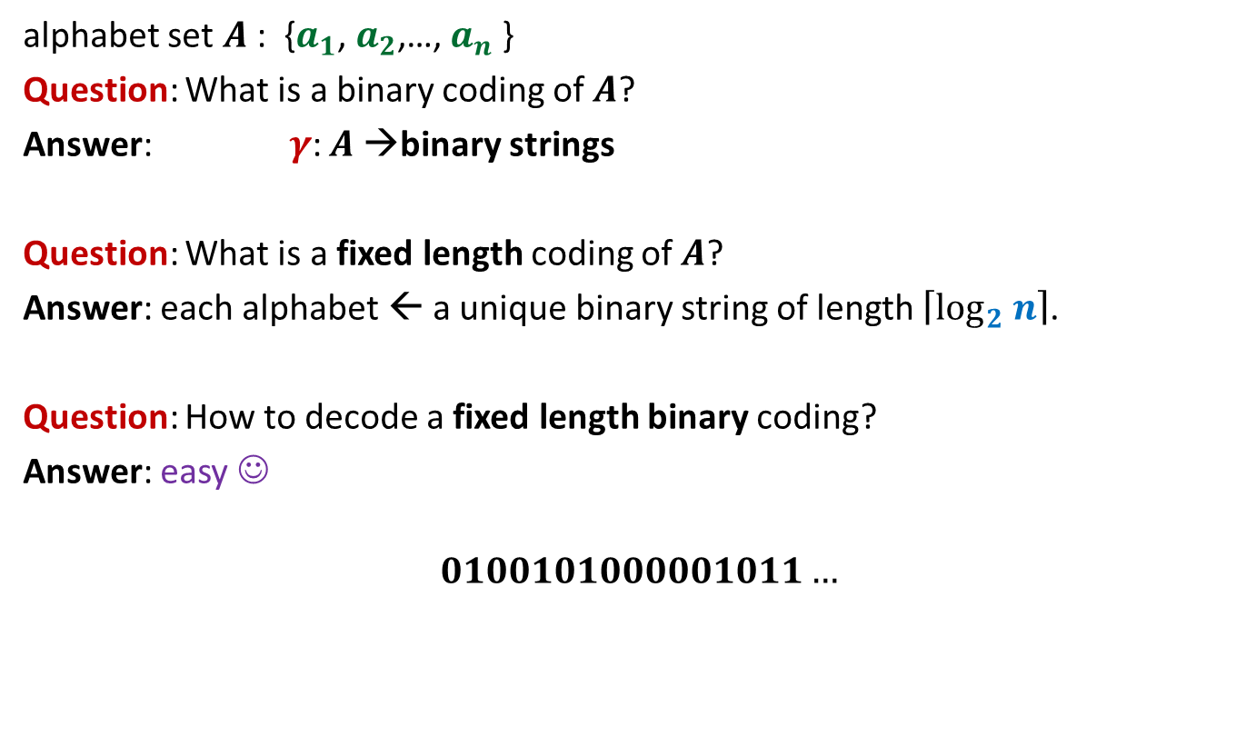
Fixed length coding
alphabet set $A$: {$a_{1}$, $a_{2}$,…, $a_{n}$ }
Question: What is a binary coding of $A$?
Answer: $γ$: $A$→binary strings
Question: What is a fixed length coding of $A$?
Answer: each alphabet ← a unique binary string of length $\left\lceil \log_{2} n\right\rceil$.
Question: How to decode a fixed length binary coding?
Answer: easy ☺
$$0100101000001011…$$

Slide 15

Fixed length coding
alphabet set $A$: {$a_{1}$, $a_{2}$,…, $a_{n}$ }
Question: Can we use fewer bits to store alphabet set $A$ ?
Answer: No.
Question: Can we use fewer bits to store a file ?
Answer: Yes

Slide 16
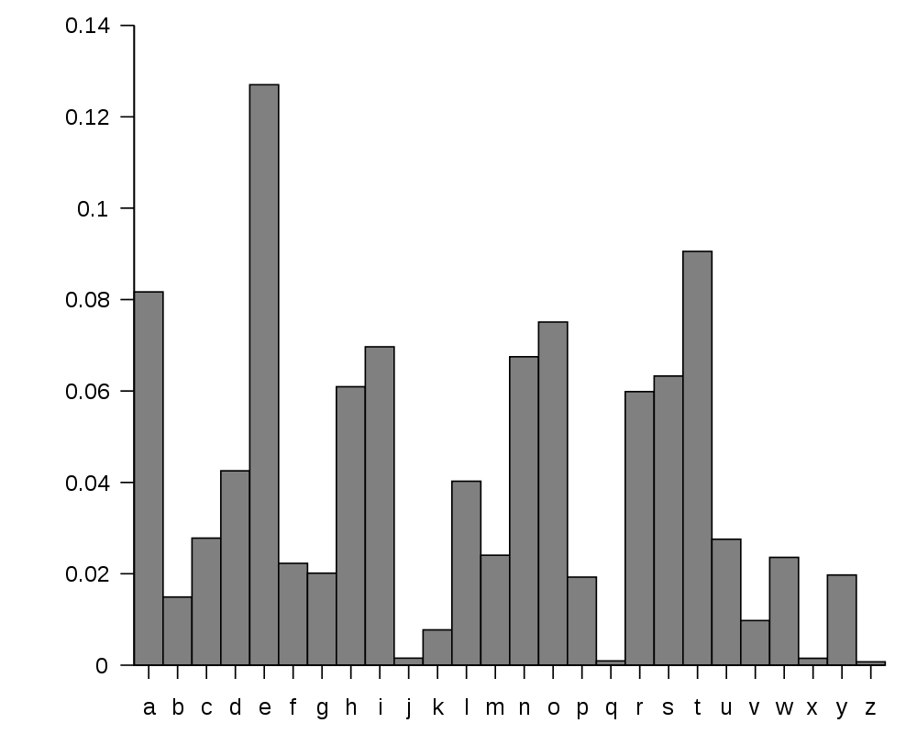
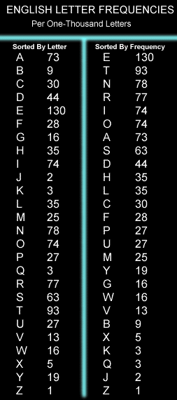
huge variation in the frequency of alphabets in a text.
http://en.wikipedia.org/wiki/Letter_frequency

Slide 17
huge variation in the frequency of alphabets in a text.
Question: How to exploit variation in the frequencies of alphabets ?
Answer:
More frequent alphabets ⬅ coding with shorter bit string
Less frequent alphabets ⬅ coding with longer bit string

Slide 18
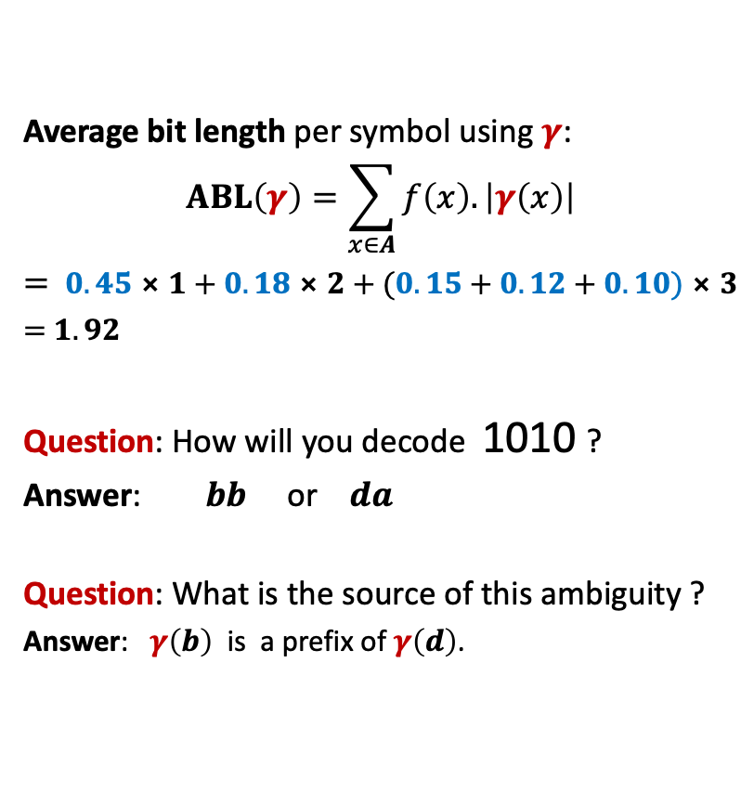
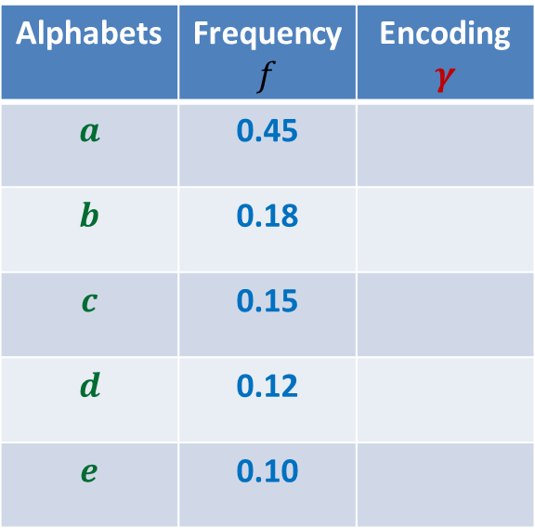
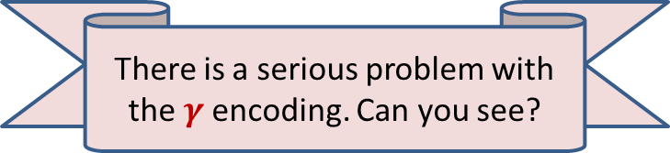
Variable length encoding
Average bit length per symbol using $γ$:
$$ABL\left(γ\right)=\sum_{x∈A}{f\left(x\right).\left|γ\left(x\right)\right|}$$
$=$ $0.45⨯1+0.18⨯2+(0.15+0.12+0.10)⨯3$
$=$ $1.92$
Question: How will you decode 1010 ?
Answer: $bb$ or $da$
Question: What is the source of this ambiguity ?
Answer: $γ\left(b\right)$ is a prefix of $γ\left(d\right)$.
?
?
Alphabets | Frequency $f$ | Encoding $$γ$$
$$a$$ | 0.45
$$b$$ | 0.18
$$c$$ | 0.15
$$d$$ | 0.12
$$e$$ | 0.10
0
10
110
101
111
There is a serious problem with the $γ$encoding. Can you see?
Can we fix it ?

Slide 19

Variable length encoding
Average bit length per symbol using $γ$:
$$ABL\left(γ\right)=\sum_{x∈A}{f\left(x\right).\left|γ\left(x\right)\right|}$$
$=$ $0.45⨯1+0.18⨯3+(0.15+0.12+0.10)⨯3$
$=$ $2.1$
Alphabets | Frequency $f$ | Encoding $$γ$$
$$a$$ | 0.45
$$b$$ | 0.18
$$c$$ | 0.15
$$d$$ | 0.12
$$e$$ | 0.10
0
100
110
101
111

Slide 20
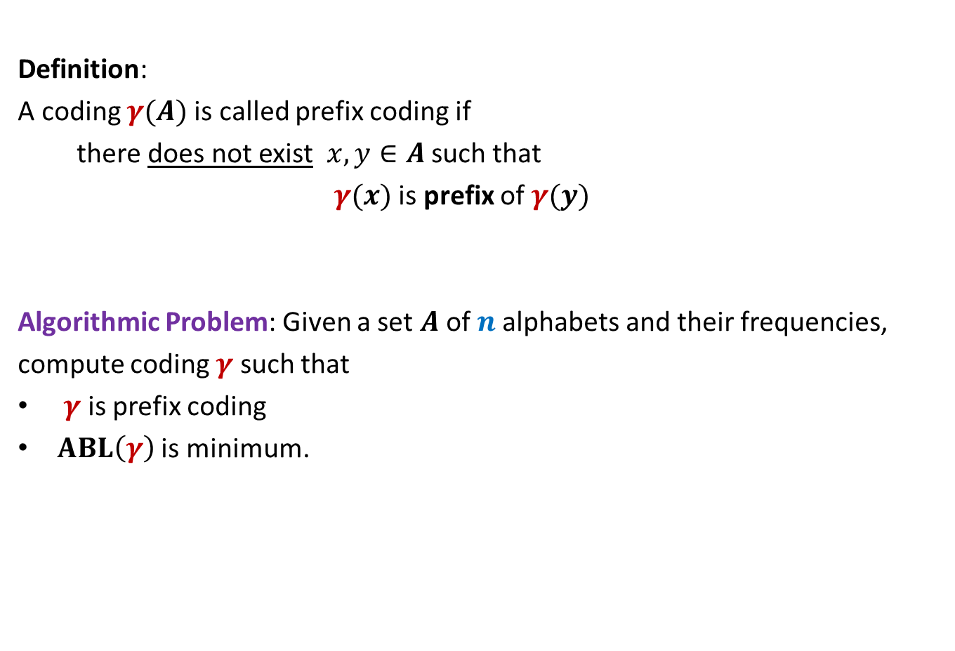
Prefix Coding
Definition:
A coding $γ(A)$is called prefix coding if
there does not exist $x,y∈A$ such that
$γ(x)$ is prefix of $γ(y)$
Algorithmic Problem: Given a set $A$of $n$alphabets and their frequencies,
compute coding $γ$ such that
$γ$ is prefix coding
$ABL\left(γ\right)$ is minimum.

Slide 21

The challenge of the problem
Among all possible binary coding of $A$, how to find the optimal prefix coding ?
It looks too complex ☹

Slide 22
The novel idea of Huffman
?
0
1
0
1
0
1
Binary coding
Labeled
Binary tree

Slide 23
A labeled binary tree
nodes → ?
Code of an alphabet = ?
0
1
0,
00,
001
01,
1,
10,
100,
101
0
1
0
1
0
1
alphabets
Label of path from root

Slide 24
prefix codes and labeled Binary tree

Slide 25
A labeled binary tree
Consider a prefix code 101
0
1
1
0
Visualize a binary tree for the prefix code ?
0
1

Slide 26
A labeled binary tree
0
1
0
1
1
0
0
1
0
1
0
1
0
1

Slide 27
A labeled binary tree
Work with the corresponding binary tree for 30 minutes
to design algorithm for computing prefix coding with least ABL.
leaf nodes → alphabets
Code of an alphabet =
0
1
01,
001,
0000,
11,
100,
10110,
10111
0
1
1
0
0
1
0
1
0
1
0
1
Label of path from root

